Slide 1
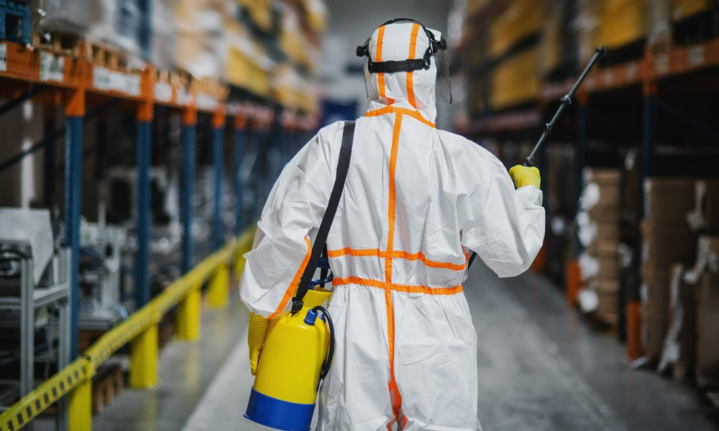
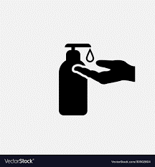

SANITIZATION MANAGEMENT SYSTEM
Presented By,
BIBIN THOMAS

Slide 2

01
Abstract
Requirements
02
03
Technical
Aspects
Table of
Contents
Challenges
04
05
Features
Future
06
07
Conclusion
Reference
08
Notes:
Photo by Sean Pollock on Unsplash

Slide 3
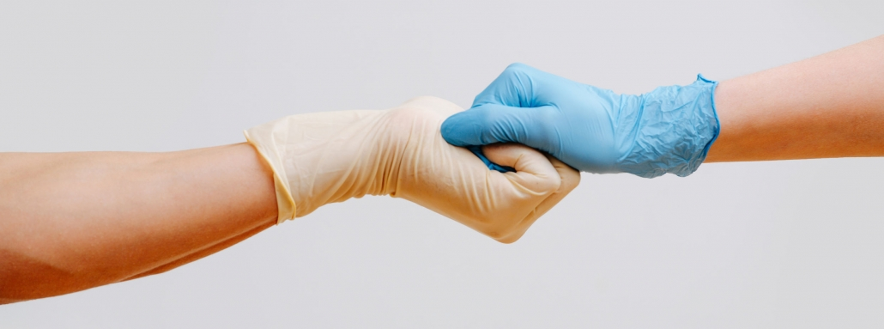
ABSTRACT
Web-based application developed in Python and SQLite.
Nowadays it is very important to sanitize and disinfect each & everything.
Purpose is to provide sanitization services to clean and disinfect the environment.
Systematically record, store and update the user data and service rendered.
Overview

Slide 4

Requirements
User
Register and login
Fill the Request form - Fill the form with the details needed
Slot booking – Book the slot for sanitizing according to time and date
Will Receive a tracking id-To track the request
Tract the request – To view the status of request
Contact us – To contact if any query arises
About us - View about the website

Slide 5
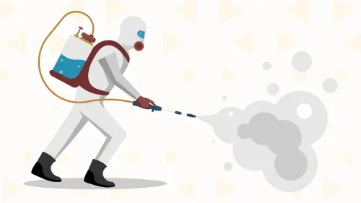

Requirements
Admin
Manage Sanitization Services
Manage Sanitization Request
Manage User Queries
Can take action on request

Slide 6





Technical Aspects
Python
SQLite
Jazzmin
PyCharm
Bootstrap
general-purpose
interactive
object- oriented scripting language
high-level programming language
SQL database engine
high-reliability
free to use
Jazz up Admin Site
Responsive
Customisable UI
Python IDE
Tightly Integrated
Most popular HTML, CSS, and JavaScript framework.
Free to download and use

Slide 7
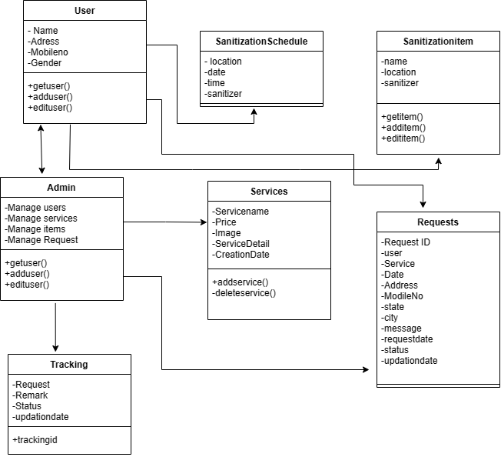
Class Diagram

Slide 8
CHALLENGES
Database Management
Configuring and managing the database connections, migrations, and data models was bit challenging, especially when dealing with complex relationships and data transformations.
Authentication and Authorization
Implementing user authentication, managing user roles and permissions, and securing sensitive data
URL Routing and Views
Configuring URL routing patterns and mapping them to appropriate views was confusing at times, especially when dealing with dynamic URLs, query parameters, and complex URL structures.
Templating and Front-end Integration
Integrating front-end frameworks like Bootstrap and handling dynamic content rendering through Django's template engine..
DURING
DEVELOPMENT

Slide 9
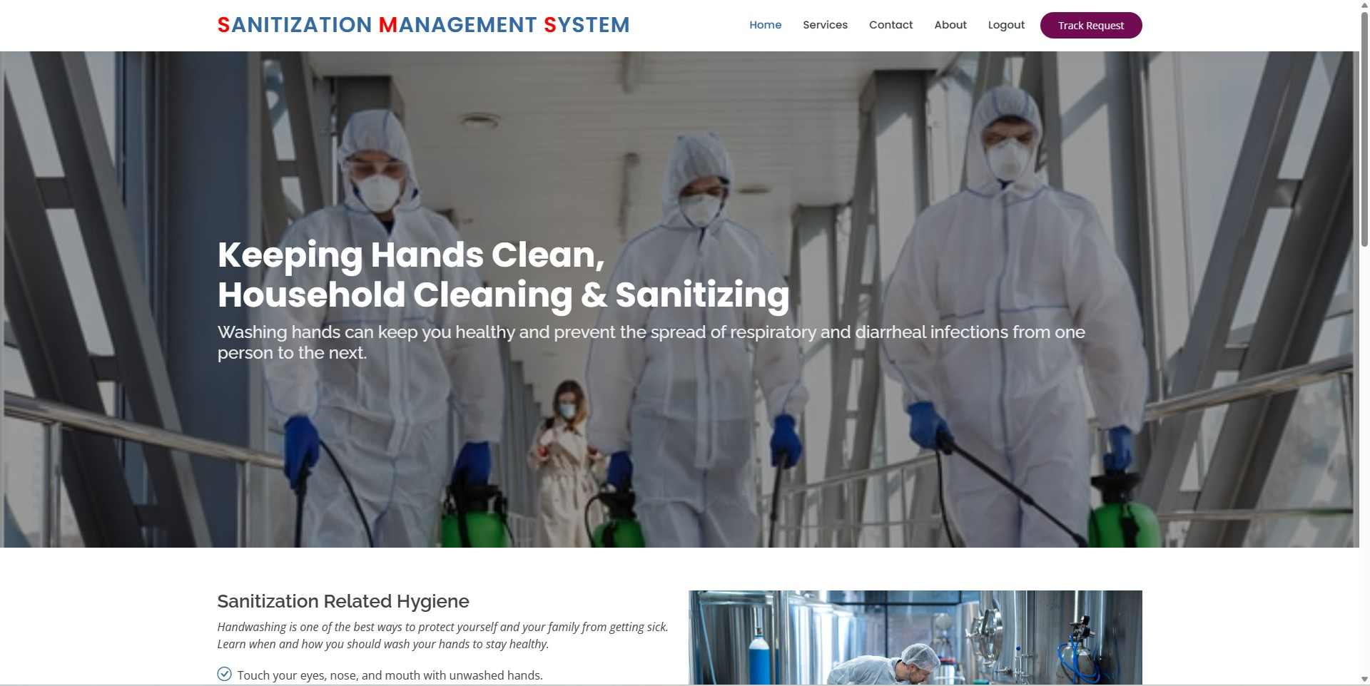
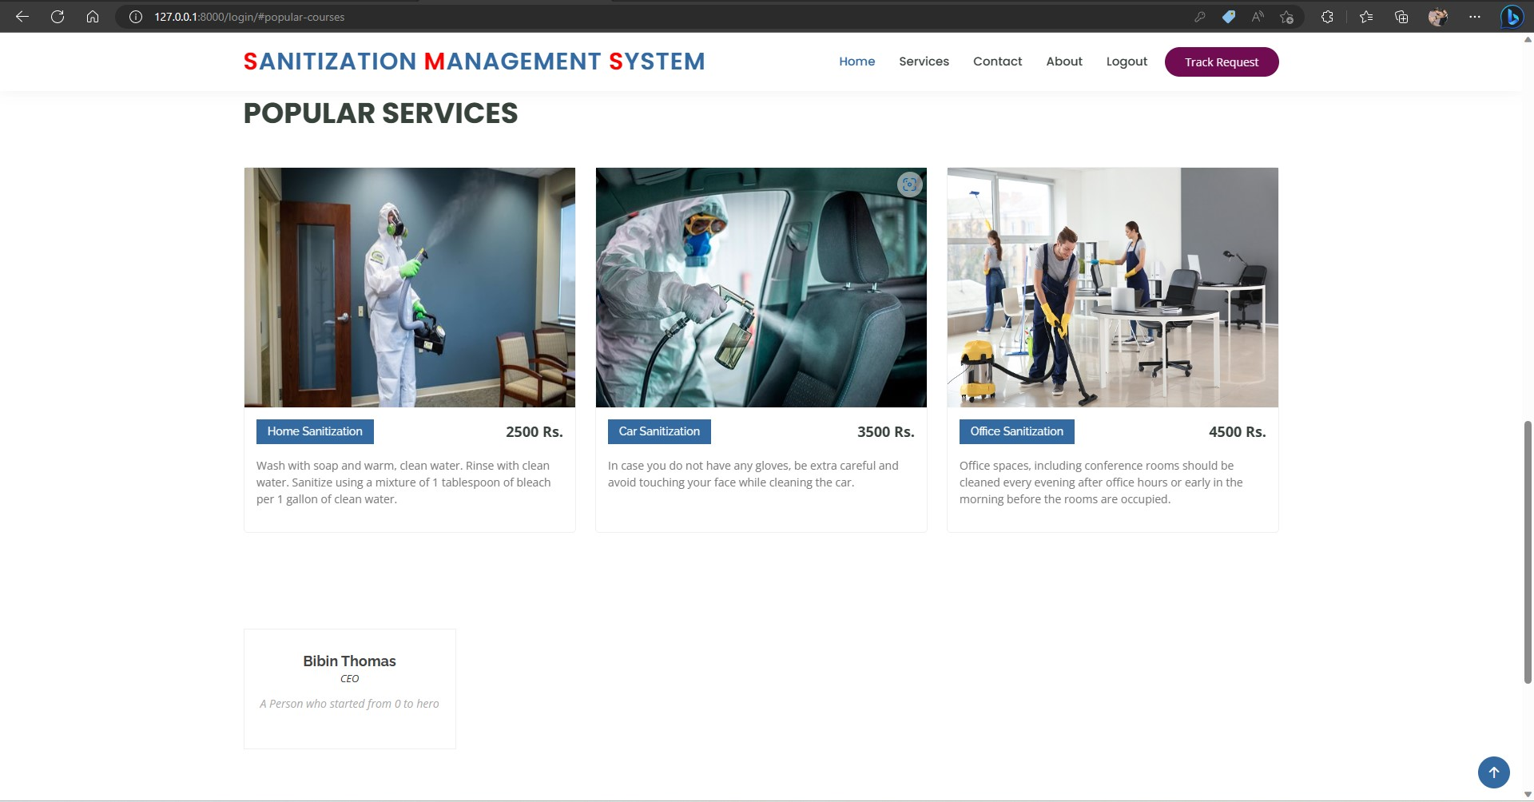
Features
User Dashboard
Interface After Login
Can navigate to different options
Services provided
Various Services
With details and rate

Slide 10
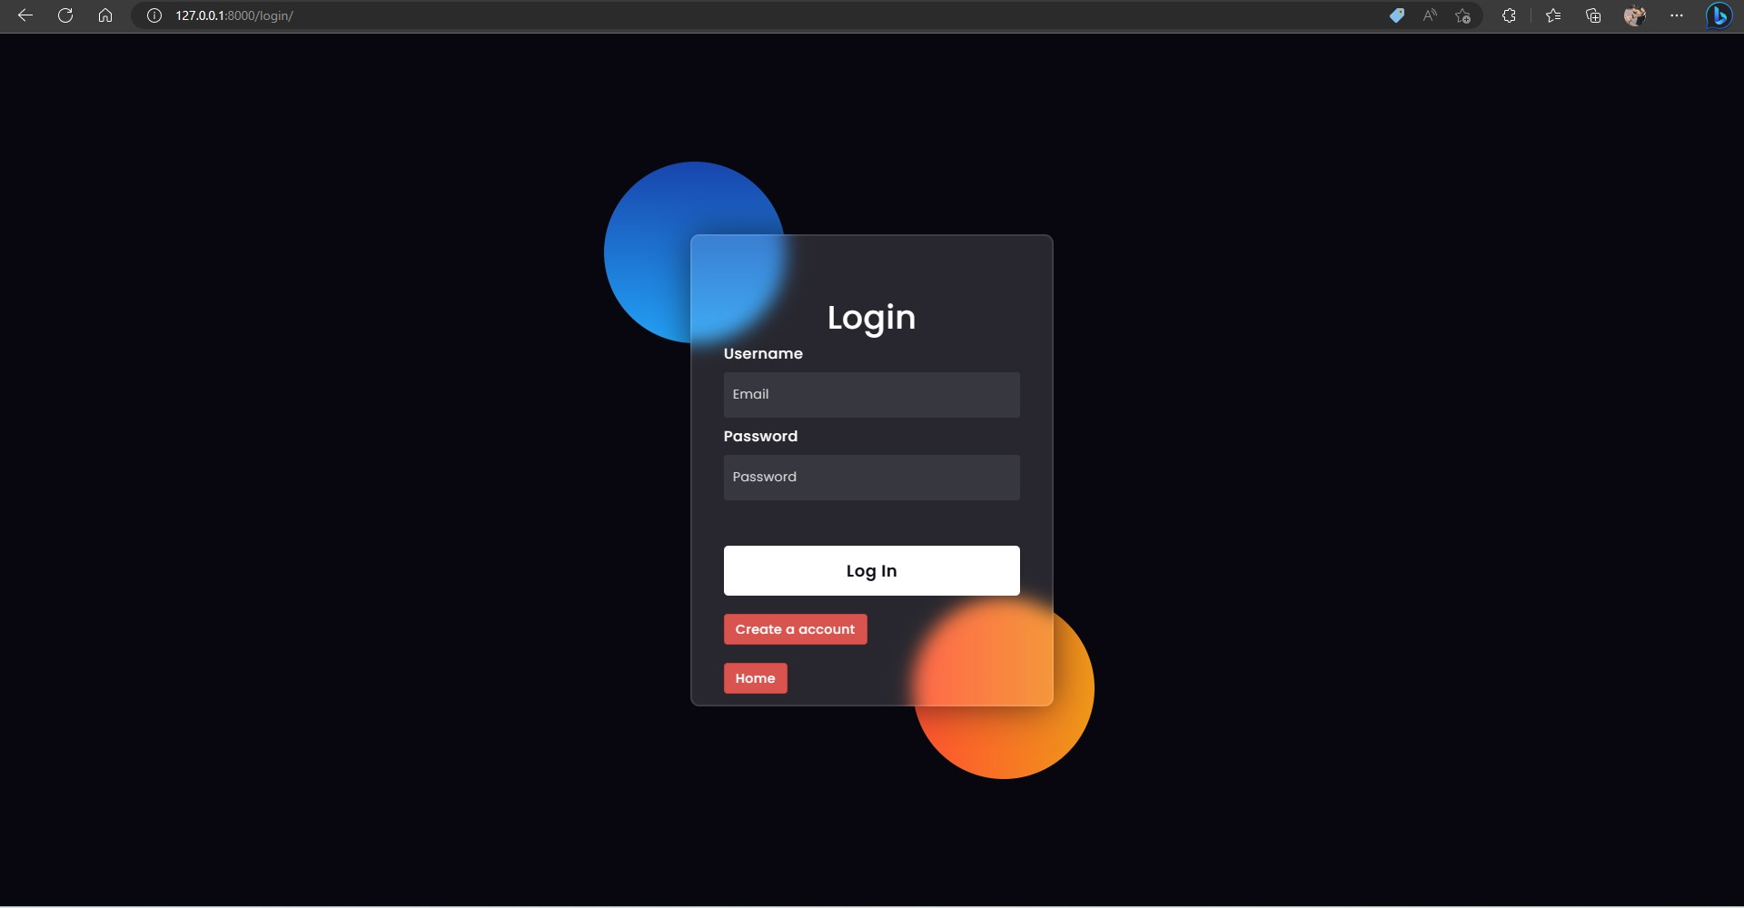
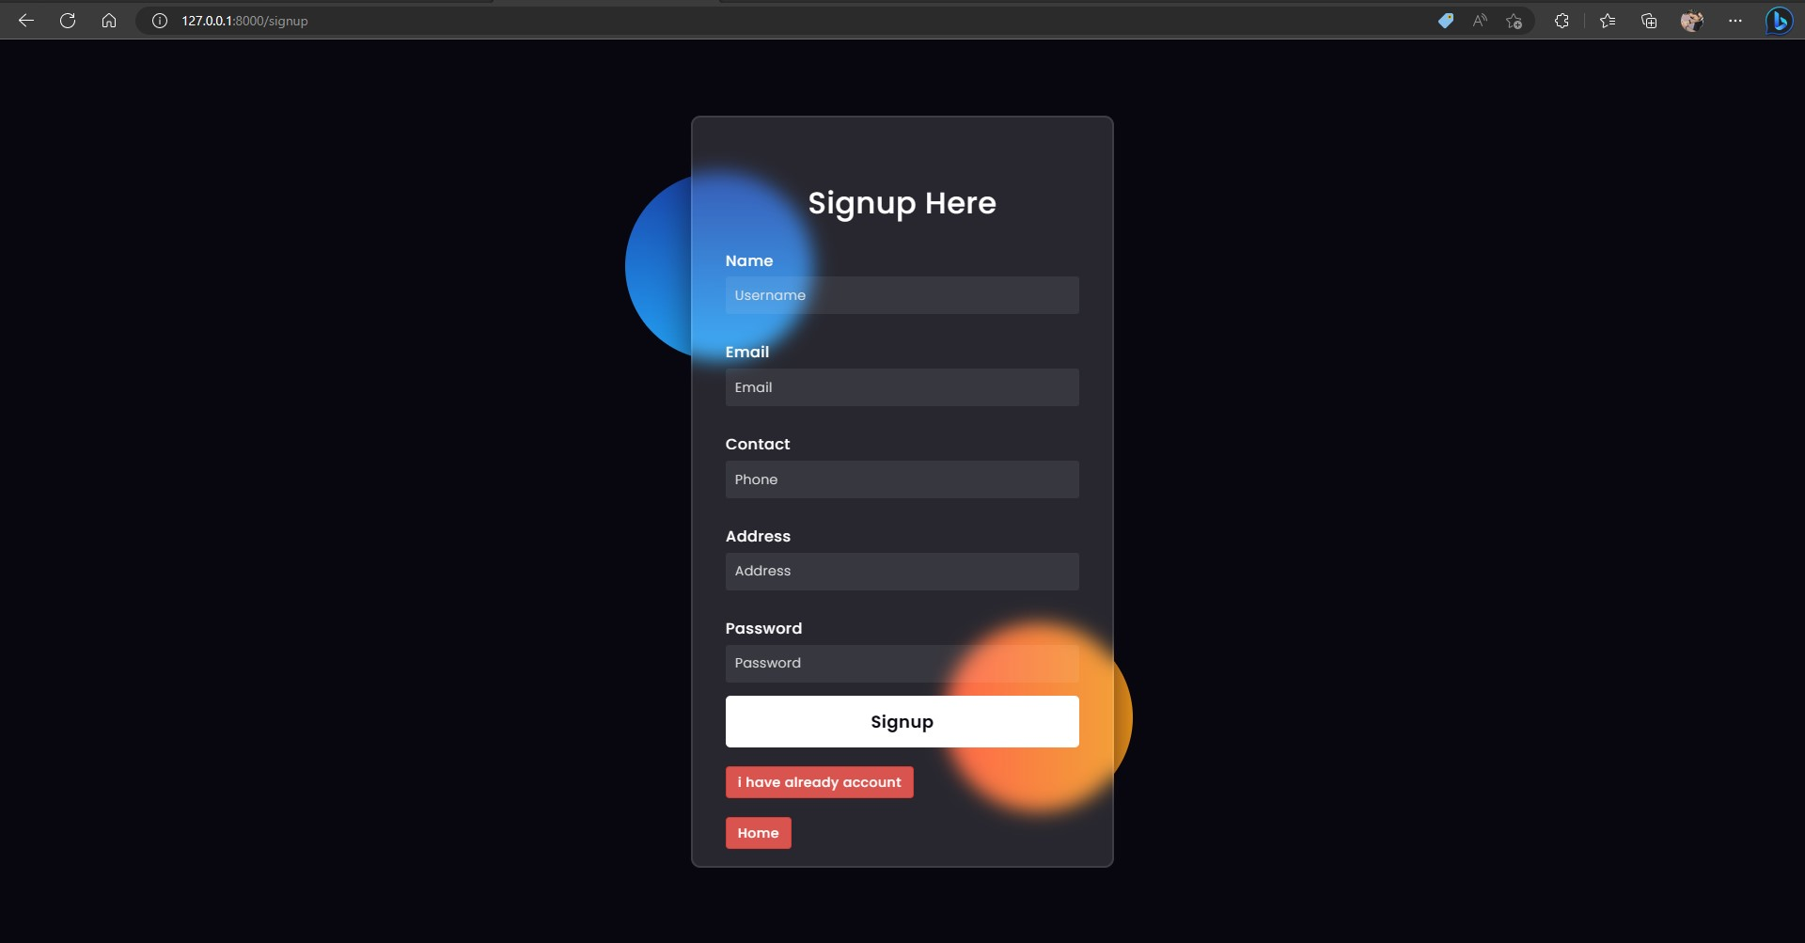
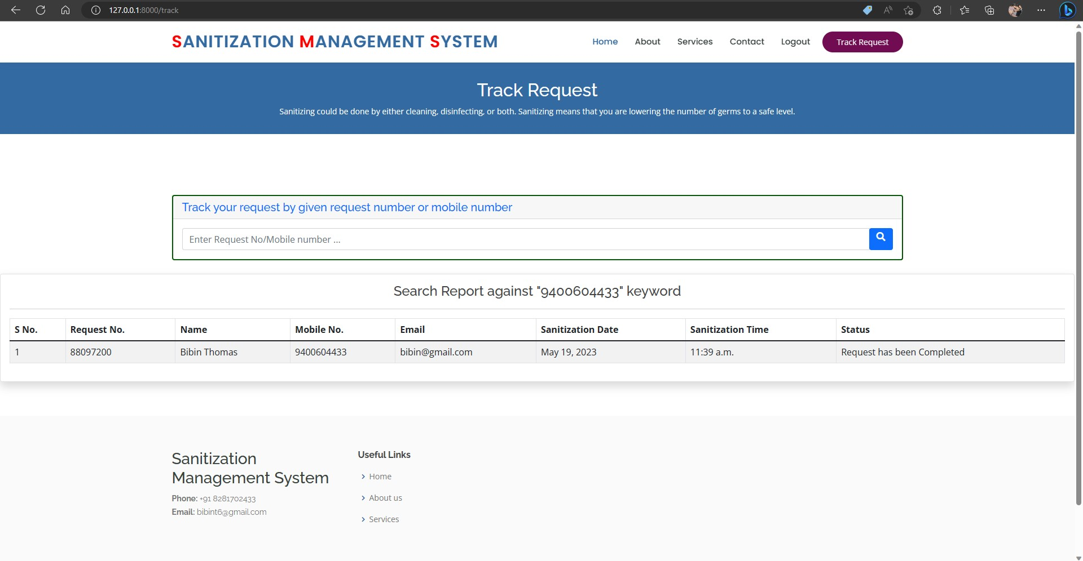
Request tracking
Track the request
Using Tracking id or mob no:
Sign in & sign up
Adds security

Slide 11
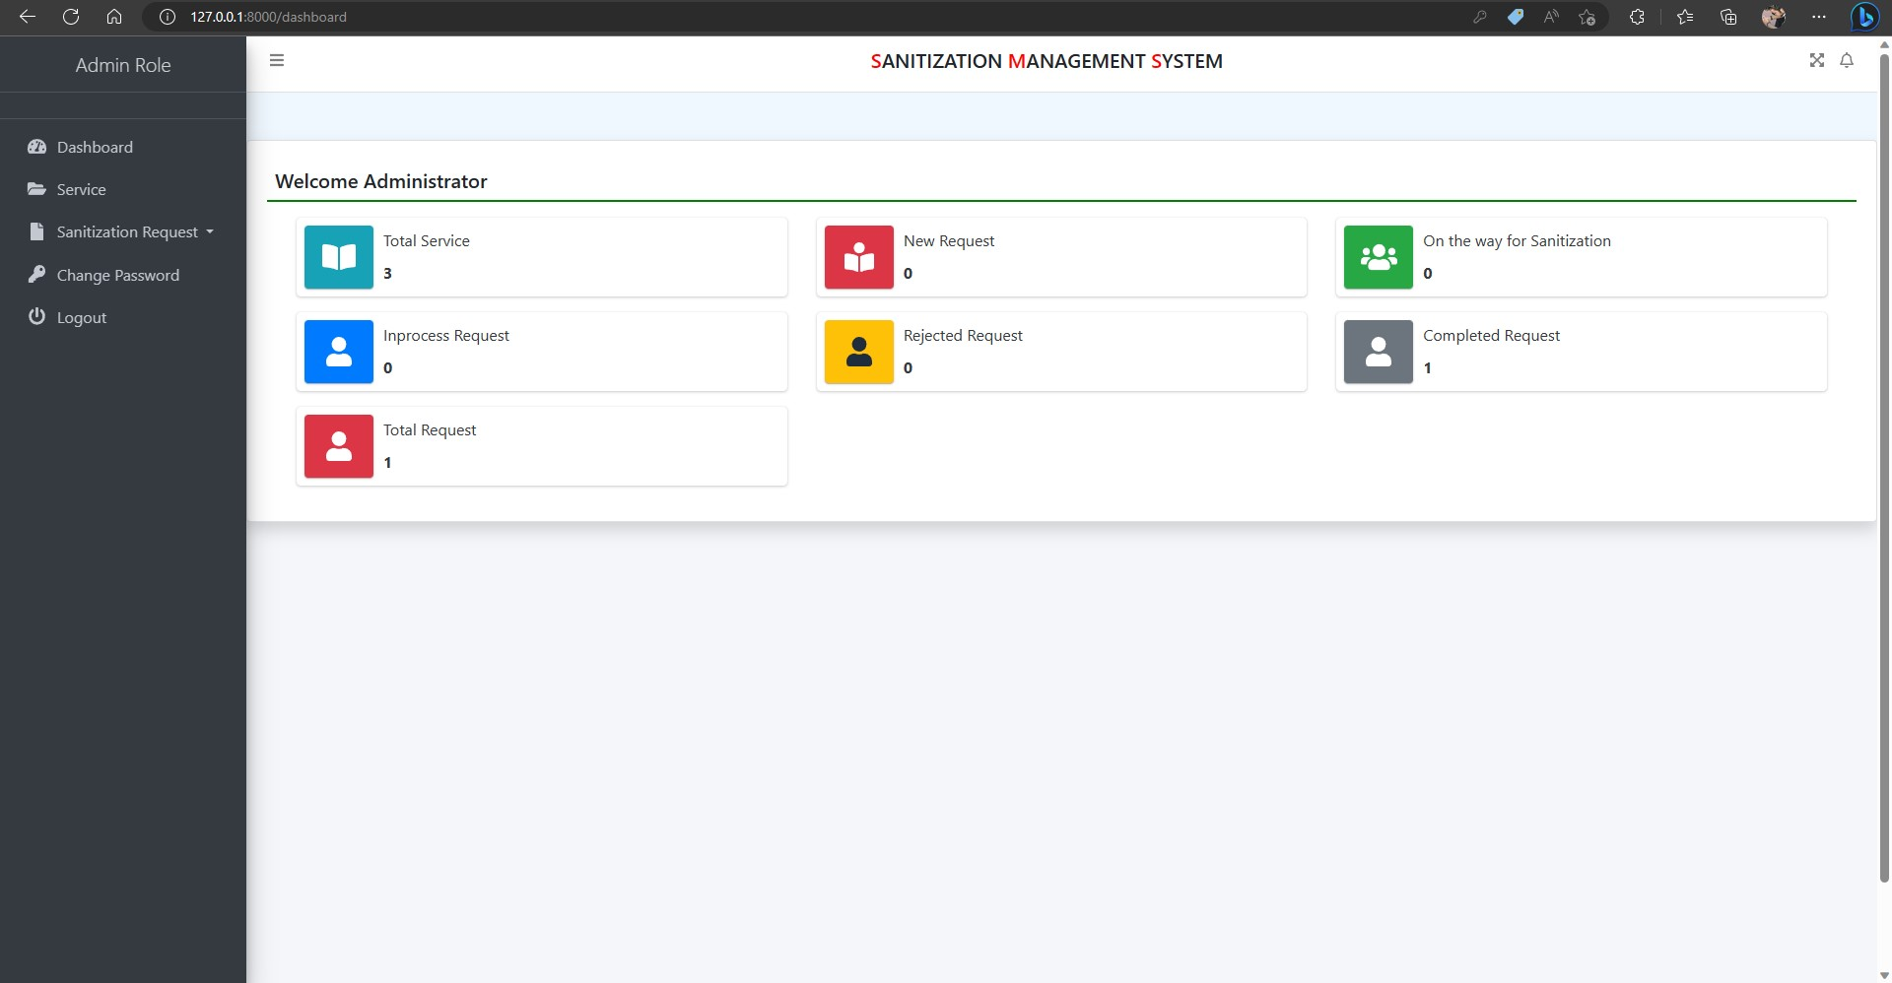
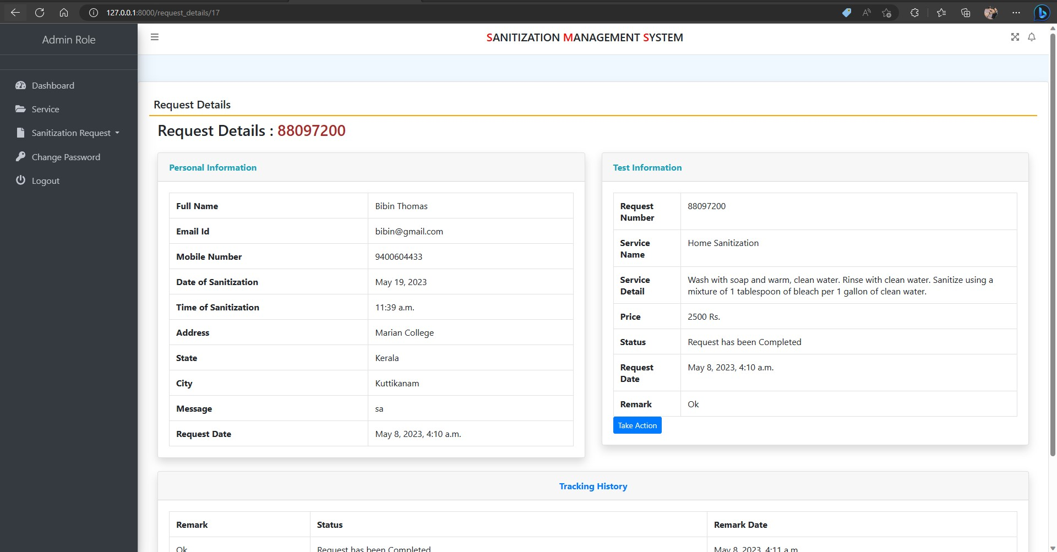
Admin Dashboard
Interface After Login
Can navigate to different options
Request details
View Request
Can take action

Slide 12


ENHANCEMENT
Email delivery of Tracking Id - Implementing an automated email delivery system
In-app messaging and chat support - Including an in-app messaging or chat support feature would enable users to communicate directly with the sanitization service provider.
Multi-platform accessibility - Expanding the system's accessibility across multiple platforms such as web, mobile, and tablet devices

Slide 13
CONCLUSION
Can be used by any sanitization companies for keeping record of users.
Easy, Fast and user Friendly Interface.
Makes entire process online and can generate reports.
Designed in such a way that future changes can be done easily

Slide 14
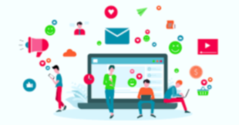
Reference
Lightweight Django by Elman and Mark Lavin
J. Martin, Computer Database Organization, Prentice-Hall

Slide 15
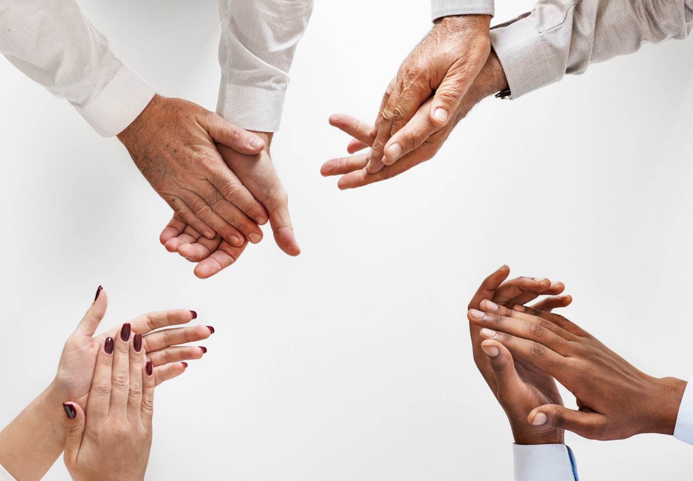
Thank You

